Slide 1
Probability
EQ – How do I calculate probabilities of combined events using two-way tables?

Slide 2
Lesson objective
By the end of this lesson you will be able to;
Use 2-way tables to calculate probabilities
Use 2-way tables to calculate probabilities in situations involving replacement and where there is no replacement
B grade and above: you will be able to construct and use 2-way tables to calculate probabilities in situations involving replacement and where there is no replacement
Notes:
Lesson

Slide 3
24
7
30
Topic: Two step Probability with replacement
Date:
EQ – How do I calculate probabilities of combined events using two-way tables?
A two – way table is one way to display the outcome of a 2 step experiment. We use the results to calculate probability.
When an experiment involves 2 or more components, such as flipping a coin twice, we are dealing with combined events.
The outcome for such an event depends on whether or not they are conducted with or without replacement.
What this means:
If replacement is allowed, then the outcomes from each selection can be repeated
If selections are made without replacement, then the outcomes from each selection cannot be repeated
It makes a big difference whether selections are replaced or not.
Two Way Table

Slide 4
Probability with and without Replacement
https://www.youtube.com/watch?v=uKTjh-6PFjo

Slide 5
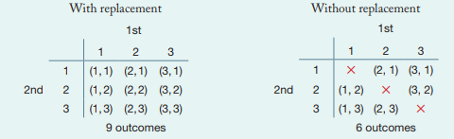
Example 1:With Replacement
You have 3 sets of cards labelled: 1, 2 and 3. Two selections are made each time.
Here is a two-way table showing the outcomes when the card is replaced each time

Slide 6
Example 2: Without replacement
You have 3 sets of cards labelled: 1, 2 and 3. Two selections are made each time.
Here are two-way tables showing the outcomes when the first card chosen is not replaced

Slide 7
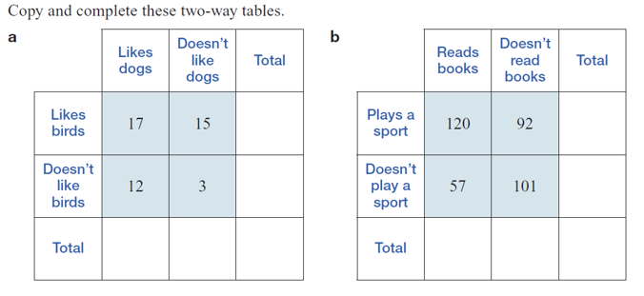
Completing Data in Two-Way Tables
Notes:
Guided practice

Slide 8
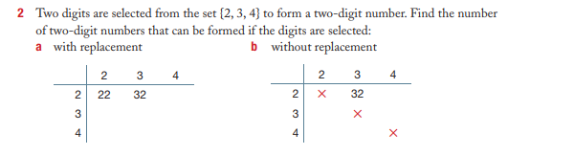
Using two-way tables to calculate probabilities in situations that involve replacement and no replacement

Slide 9
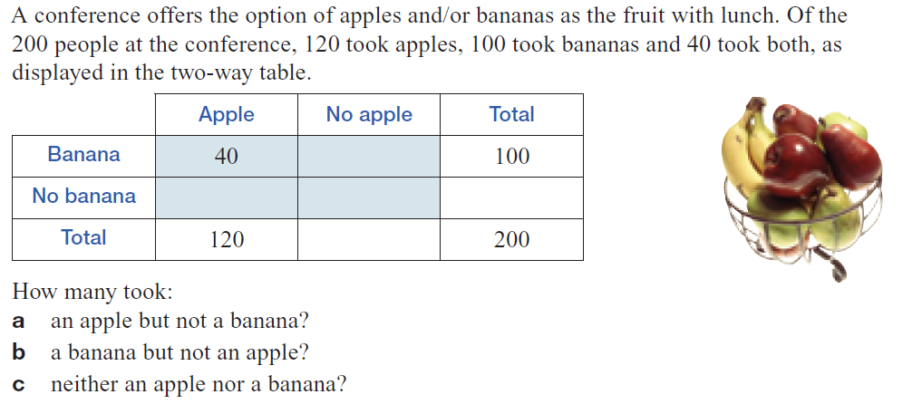
Using two-way tables to calculate probabilities
Notes:
Guided practice

Slide 10
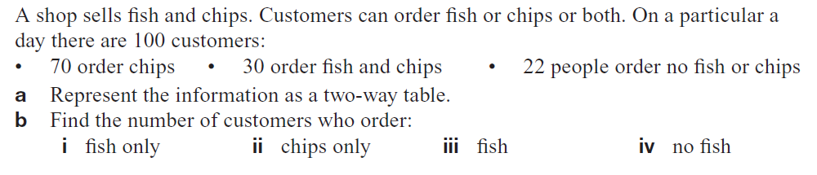

Slide 11
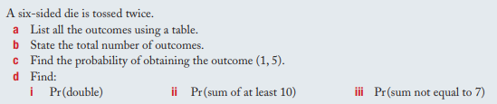
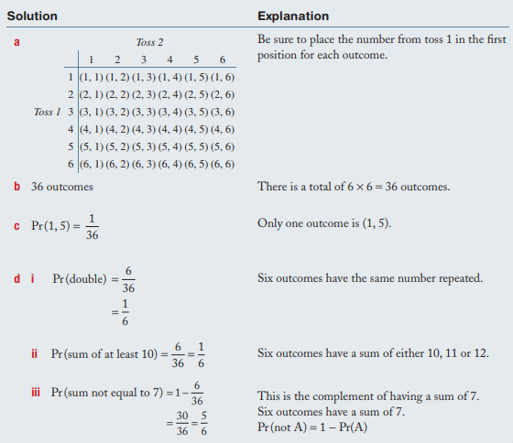
Example 3: Constructing a table with replacement
B-Grade
Not: Pr in this case is the same as P. Both are shorthand for “probability”
Notes:
Guided practice

Slide 12
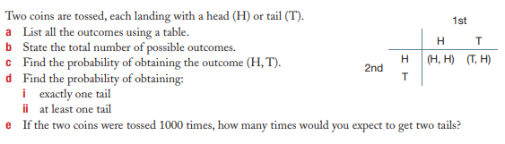
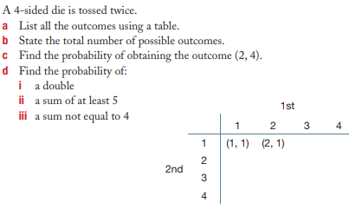
Your turn: Complete this in your Interactive notebook
Constructing two-way tables to calculate probabilities in situations that involves replacement
1.
2.

Slide 13
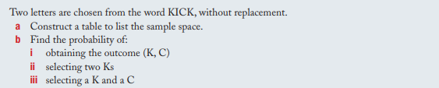
Example 3: Constructing a table without replacement
B-Grade
Not: Pr in this case is the same as P. Both are shorthand for “probability”
Notes:
Guided practice

Slide 14
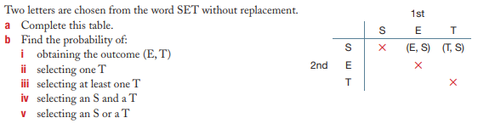
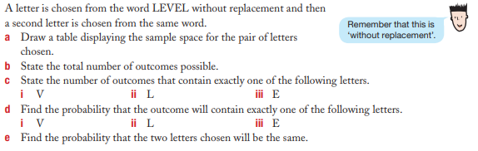
Your turn: Complete this in your Interactive notebook
Constructing two-way tables to calculate probabilities in situations that involves no replacement
1.
2.

